Slide 1

Network Layer
PRESENTED BY: MD. FAHAD BIN ZAMAL

Slide 2

Basic of Networking

Slide 3
Decimal to Binary
172
172 – Base 10
1
10
100
1000
2
70
100
172
10⁰ = 1
10¹ = 10
10² = 100
10³ = 1000
10101100
2⁰ = 1
2¹ = 2
2² = 4
2³ = 8
2⁴ = 16
2⁵ = 32
2⁶ = 64
2⁷ = 128
10101100– Base 2
1
2
4
8
16
32
64
128
0
0
4
8
0
32
0
128
172

Slide 4
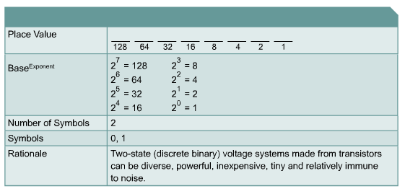
Base 2 Number System
10110₂ = (1 x 2⁴ = 16) + (0 x 2³ = 0) + (1 x 2² = 4) +
(1 x 2¹ = 2) + (0 x 2⁰ = 0) = 22

Slide 5
Converting Decimal to Binary
Convert 201₁₀ to binary:
201 / 2 = 100 remainder 1
100 / 2 = 50 remainder 0
50 / 2 = 25 remainder 0
25 / 2 = 12 remainder 1
12 / 2 = 6 remainder 0
6 / 2 = 3 remainder 0
3 / 2 = 1 remainder 1
1 / 2 = 0 remainder 1
When the quotient is 0, take all the remainders in reverse order for your answer: 201₁₀ = 11001001₂

Slide 6
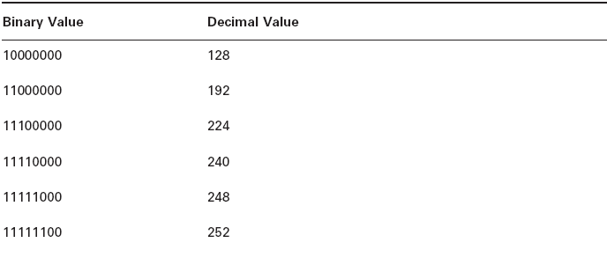

Binary to Decimal Chart

Slide 7
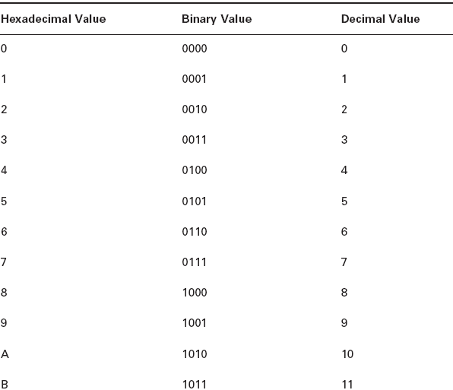
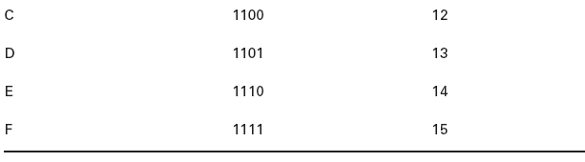
Hex to Binary to Decimal Chart

Slide 8


Slide 9
Self Assessment:
What is the decimal value of binary 00001110 ?
A. 13
B. 14
C. 1,110
D. 16
What is the binary value of decimal 256?
A. 11111111
B. 1111111111
C. 100000000
D. 10000000
Notes:
B, C

Slide 10
Self Assessment:
Write the following binary IP in dotted-decimal format:
11000000.10101000.00000001.11111110
What is 127.0.0.1 in binary?
Notes:
192.168.1.254
01111111.00000000.00000000.00000001

Slide 11


Slide 12


Slide 13
IP Addressing
32 Bits
Dotted
Decimal
Network
Host
255
255
255
255
Maximum
1
8
9
16
17
24
25
32
11111111
11111111
11111111
11111111
Binary
128
64
32
16
8
4
2
1
128
64
32
16
8
4
2
1
128
64
32
16
8
4
2
1
128
64
32
16
8
4
2
1
Example
Decimal
172
16
122
204
10101100
00010000
01111010
11001100
Example
Binary
Notes:
Layer 3 of 3
Emphasize: In layer 3, an example of dotted decimal format and binary are displayed.
IP address format is dotted decimal. Dotted decimal makes it easy to work with IP addresses. However, in this course we will work with the addresses on the bit level, so we will convert these addresses into binary, make changes to them, and convert them back.
The central authority for addresses is the Internet Assigned Numbers Authority (IANA).
Note: This most common form of addressing reflects the widely used IP version 4. Faced with the problem of depleting available addresses, Internet Engineering Task Force (IETF) work is under way for a backward-compatible next generation of IP (IPng, also called IP 6).
IP 6 will offer expanded routing and addressing capabilities with 128-bit addresses rather than the 32-bit addressing shown on the graphic. Addresses from both IP versions will coexist. Initial occurrences will probably be at locations with address translator software and firewalls.

Slide 14
IP Address Classes
8 Bits
8 Bits
8 Bits
8 Bits
Class A:
Class B:
Class C:
Class D: Multicast
Class E: Research
Network
Host
Host
Host
Network
Network
Host
Host
Network
Network
Network
Host
Notes:
Slide 1 of 2
Purpose: This graphic describes the three most common classes of IP address.
Emphasize: Discuss classes of addresses. Each address contains information about the network number and the host number of the device. Class A addresses are for very large organizations, Class B addresses are for smaller organizations, and Class C addresses for even smaller ones.
As the number of networks grows, classes may eventually be replaced by another addressing mechanism, such as classless interdomain routing (CIDR). RFC 1467, Status of CIDR Deployment in the Internet, presents information about CIDR. RFC 1817, CIDR and Classful Routing, also presents CIDR information.

Slide 15
IP Address Classes
1
8
9
16
17
24
25
32
Bits:
0NNNNNNN
Host
Host
Host
Class A:
Range (1-127)
Bits:
10NNNNNN
Network
Host
Host
Class B:
Range (128-191)
Bits:
110NNNNN
Network
Network
Host
Class C:
Range (192-223)
Bits:
1110MMMM
Multicast Group
Multicast Group
Multicast Group
Class D:
Range (224-239)
Notes:
Slide 2 of 2
Emphasize: Highlight the fixed values that start each class address.
The first octet rule states that when an address falls into a specified range, it belongs to a certain class. Students should soon be able to recognize the address class of any IP address on sight.
Note: If time or interest permits, you can use the initial bit patterns in the first octet and show how a class of IP network derives the range of network numbers for that IP address class.

Slide 16
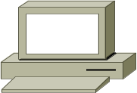

Host Addresses
172.16.2.2
10.1.1.1
10.6.24.2
E1
172.16.3.10
E0
10.250.8.11
172.16.2.1
172.16.12.12
10.180.30.118
Routing Table
172.16
Network
Interface
.
12
.
12
Network
Host
172.16.0.0
10.0.0.0
E0
E1
Notes:
Purpose: This figure presents an overview of host and network address conventions.
Emphasize: In the example, 172.16.0.0 and 10.0.0.0 refer to the wires at each end of the router.
Explain how the routing table is used. Entries in the routing table refer to the network only. The router does not know the location of hosts; it knows the location of networks.
.

Slide 18
Self Assessment:
What class of IP address is 191.168.1.0?
What is the range (in decimal) of Class B addresses?
What is the range of Class A addresses?

Slide 19
IP Address Classes Exercise
Address
Class
Network
Host
10.2.1.1
128.63.2.100
201.222.5.64
192.6.141.2
130.113.64.16
256.241.201.10
Notes:
Layer 1 of 2
Purpose: This exercise verifies that the students understand IP address classes, network numbers, and host numbers.
Give the students time to list the address class, network, and host number for each IP address in the table. Review the correct answers interactively.
The answers are given in the following figure.

Slide 20
IP Address Classes Exercise Answers
Address
Class
Network
Host
10.2.1.1
A
10.0.0.0
0.2.1.1
128.63.2.100
B
128.63.0.0
0.0.2.100
201.222.5.64
C
201.222.5.0
0.0.0.64
192.6.141.2
C
192.6.141.0
0.0.0.2
130.113.64.16
B
130.113.0.0
0.0.64.16
256.241.201.10
Nonexistent
Notes:
Layer 2 of 2
Purpose: The answers to the exercise are given in the figure.
Note: Students can also find the answers to this exercise in the Appendix D, “Answers.”

Slide 21


Slide 22


Slide 23
Subnetting
Subnetting is logically dividing the network by extending the 1’s used in SNM
Advantage
  Can divide network in smaller parts
  Restrict Broadcast traffic
  Security
  Simplified Administration

Slide 24
Subnetting
Classful IP Addressing SNM are a set of 255’s and 0’s.
In Binary it’s contiguous 1’s and 0’s.
SNM cannot be any value as it won’t follow the rule of contiguous 1’s and 0’s.
Possible subnet mask values
  0
  128
  192
  224
  240
  248
  252
  254
  255
Notes:
Advantages of Subnetting
Subnetting is often used to accommodate a divided physical topology or to restrict
broadcast traffic on a network.Other advantages of subnetting include improved secu ­
rity (by restricting unauthorized traffic behind routers)and simplified administration
(by delegating control of subnets to other departments or administrators).
Accommodating Physical Topology Suppose you are designing a campus network
with 200 hosts spread over four buildings —Voter Hall,Twilight Hall,Monroe Hall,
and Sunderland Hall.You want each of these four buildings to include 50 hosts.If
your ISP has allocated to you the Class C network 208.147.66.0,you can use the
addresses 208.147.66.1 –208.147.66.254 for your 200 hosts.
Restricting Broadcast Traffic A broadcast is a network message sent from a single
computer and distributed to all other devices on the same physical network segment.
Broadcasts are resource-intensive because they use up network bandwidth and request
the attention of every network adapter and processor on the local network segment.
Routers block broadcasts and protect networks from becoming overburdened with
unnecessary traffic.Because routers also define the logical limits of subnets,subnet ­
ting a network indirectly allows you to limit the propagation of broadcast traffic in
that network.

Slide 25

Addressing Without Subnets
172.16.0.1
172.16.0.2
172.16.0.3
172.16.255.253
172.16.255.254
…...
172.16.0.0
Network 172.16.0.0
Notes:
Purpose: This figure explains what networks look like without subnets.
Emphasize: Without subnets, use of network addressing space is inefficient.
The Class B network is like a highway with no exits—there is no place to exit, so all of the traffic is in one line.

Slide 26
Addressing with Subnets
172.16.3.0
172.16.4.0
172.16.1.0
172.16.2.0
Network 172.16.0.0
Notes:
Purpose: This figure describes network structure when subnets are used.
Emphasize: The host bits of an IP address can be subdivided into a subnetwork section and a host section. The subnetwork section in this example is the full third octet.
Point out the difference in the addressing between the previous slide and this slide.
A subnetted address space is like a highway with exits.
A network device uses a subnet mask to determine what part of the IP address is used for the network, the subnet, and the device ID.
A subnet mask is a 32-bit value containing a number of one bits for the network and subnet ID, and a number of zero bits for the host ID.
Given its own IP address and subnet mask, a device can determine if an IP packet is destined for 1) a device on its own subnet, 2) a device on a different subnet on its own network, or 3) a device on a different network.
A device can determine what class of address the device has been assigned from its own IP address. The subnet mask then tells the device where the boundary is between the subnet ID and the host ID.

Slide 27
Subnet Addressing
172.16.2.200
172.16.3.5
172.16.3.1
E1
172.16.2.2
E0
172.16.3.100
172.16.2.1
172.16.2.160
172.16.3.150
New Routing Table
172.16
Network
Interface
.
2
.
160
Network
Host
172.16.0.0
172.16.0.0
E0
E1
Notes:
Layer 1 of 2
Purpose: This figure shows what would happen if there were no subnetting.
Emphasize: If networks could not be broken down into more granular subnetworks, few networks could exist, each with a capacity for many hosts.

Slide 28
Subnet Addressing
172.16.2.200
172.16.3.5
172.16.3.1
E1
172.16.2.2
E0
172.16.3.100
172.16.2.1
172.16.2.160
172.16.3.150
New Routing Table
172.16
Network
Interface
.
2
.
160
Network
Subnet
Host
172.16.2.0
172.16.3.0
E0
E1
Notes:
Layer 1 of 2
Emphasize: By turning on more bits in the mask, we reserve some bits as network information and can use these bits to describe subnetworks.
Describe how the router makes use of this technique. Point out that there is more information in the routing table now.
Note: As you enter the discussion about subnet masks, a question might arise about whether it is legal to define a discontiguous subnet mask. A discontiguous subnet mask consists of intervening zeros, as in 101111011000, rather than all ones followed by zeros, as in 1111111100000000. The question has two answers. According to RFC 950 that describes IP, a discontiguous subnet mask is legal. However, the hardware expense to produce an interface that supports discontiguous masking is cost prohibitive. Thus in practice it is not supported on most vendors’ equipment, including Cisco. Also, discontiguous masking has no benefit, and it is much more difficult to maintain a network based on this design. Later RFCs make noncontiguous subnet masks illegal because they are incompatible with future addressing schemes such as CIDR.

Slide 29
Decimal Equivalents of Bit Patterns
128 64 32 16 8 4 2 1
0 0 0 0 0 0 0 0 = 0
1 0 0 0 0 0 0 0 = 128
1 1 0 0 0 0 0 0 = 192
1 1 1 0 0 0 0 0 = 224
1 1 1 1 0 0 0 0 = 240
1 1 1 1 1 0 0 0 = 248
1 1 1 1 1 1 0 0 = 252
1 1 1 1 1 1 1 0 = 254
1 1 1 1 1 1 1 1 = 255
Notes:
Purpose: This figure explains how subnet masks are converted to decimal addresses.
Emphasize: Review binary-to-decimal conversion, bit weighting, and conversion.
Explain the logical AND.
One possible explanation of the logical AND follows. We will need to be able to perform a logical AND on the binary numbers. Just take two binary numbers and place one above the other. The ones in the bottom are like a pipe—the number above it just drops through. The zeros are like a clogged pipe, so nothing comes out in the answer.
Presenting a truth table will help some students understand. You might need to give more than one explanation.
Note: You might want to hand out a binary-to-decimal conversion sheet if you have not already done so. We have not included one in the lab section. It is more useful to have one that is on a separate page from the labs.

Slide 30
Subnet Mask Without Subnets
Network
Host
172.16.2.160
10101100
00010000
00000010
10100000
255.255.0.0
11111111
11111111
00000000
00000000
10101100
00010000
00000000
00000000
Network
Number
172
16
0
0
Subnets not in use—the default
Notes:
Purpose: This graphic explains how routers use addresses that have no subnet mask.
Emphasize: Explain how masking works at the bit level. Zero bits mask host information.
Note: This is an easy place to lose students. At this point, they need to learn several abstract mathematical concepts before we can show them how to lay out an IP-addressed network. To the novice, these techniques may seem unrelated, making the presentation confusing. To a more experienced audience, these techniques will be familiar.

Slide 31
Subnet Mask with Subnets
Network
Subnet
Host
172.16.2.160
10101100
00010000
00000010
10100000
255.255.255.0
11111111
11111111
11111111
00000000
10101100
00010000
00000010
00000000
128
192
224
240
248
252
254
255
Network
Number
172
16
2
0
Network number extended by eight bits
Notes:
Slide 1 of 2
Purpose: This figure shows how the router determines an address when subnetting is used.
Emphasize: This example makes a Class B address space look like a collection of Class C address spaces.
Now the logical AND allows us to extract the subnet number as well as the assigned network number.
An exercise follows that tests the students’ understanding of subnet masks.

Slide 32
Subnet Mask with Subnets (cont.)
Network
Subnet
Host
172.16.2.160
10101100
00010000
00000010
10100000
255.255.255.192
11111111
11111111
11111111
11000000
10101100
00010000
00000010
10000000
128
192
224
240
248
252
254
255
128
192
224
240
248
252
254
255
Network
Number
172
16
2
128
Network number extended by ten bits
Notes:
Slide 2 of 2
Purpose: This figure shows how the router determines an address when subnetting is used.
Emphasize: This example is different from the previous example in that the the subnet and host are divided within an octet.
Transition: An exercise follows that tests the students’ understanding of subnet masks.

Slide 33
Subnet Mask Exercise
Address
Subnet Mask
Class
Subnet
172.16.2.10
255.255.255.0
10.6.24.20
255.255.240.0
10.30.36.12
255.255.255.0
Notes:
Layer 1 of 2
Purpose: This exercise is for the students to take the given IP addresses and associated subnet masks and perform a logical AND to extract the subnet number. Provide time in class and review the answers after most of the students have finished.
The answers are given in the following figure.

Slide 34
Subnet Mask Exercise Answers
Address
Subnet Mask
Class
Subnet
172.16.2.10
255.255.255.0
B
172.16.2.0
10.6.24.20
255.255.240.0
A
10.6.16.0
10.30.36.12
255.255.255.0
A
10.30.36.0
Notes:
Layer 2 of 2
Purpose: The answers to the exercise are given in the figure.
Note: Students can also find the answers to this exercise in the Appendix D, “Answers.”

Slide 35
Class B Subnet Example
IP Host Address: 172.16.2.121
Subnet Mask: 255.255.255.0
Network
Network
Subnet
Host
172.16.2.121:
10101100
00010000
00000010
01111001
255.255.255.0:
11111111
11111111
11111111
00000000
Subnet:
10101100
00010000
00000010
00000000
Broadcast:
10101100
00010000
00000010
11111111
Subnet Address = 172.16.2.0
Host Addresses = 172.16.2.1–172.16.2.254
Broadcast Address = 172.16.2.255
Eight Bits of Subnetting
Notes:
Purpose: This figure shows an example of a Class B network with a subnet.

Slide 36
Class C Subnet Planning Example
IP Host Address: 192.168.5.121
Subnet Mask: 255.255.255.248
Network
Network
Network
Subnet
Host
192.168.5.121:
11000000
10101000
00000101
01111001
255.255.255.248:
11111111
11111111
11111111
11111000
Subnet:
11000000
10101000
00000101
01111000
Broadcast:
11000000
10101000
00000101
01111111
Subnet Address = 192.168.5.120
Host Addresses = 192.168.5.121–192.168.5.126
Broadcast Address = 192.168.5.127
Five Bits of Subnetting
Notes:
Purpose: This figure shows an example of a Class C network with a subnet.
Emphasize: Contrast the Class C network subnet mask with the previous Class B example.

Slide 37
Classless Inter-Domain Routing (CIDR)
Basically the method that ISPs (Internet Service Providers) use to allocate an amount of addresses to a company, a home
Ex : 192.168.10.32/28
The slash notation (/) means how many bits are turned on (1s)

Slide 38
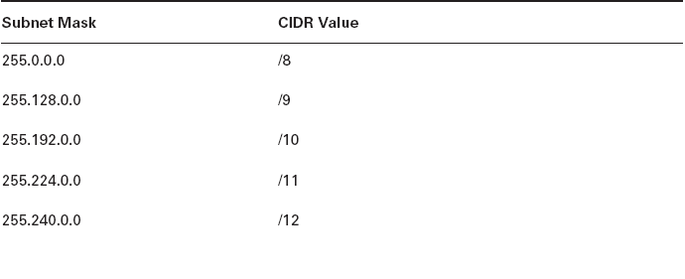
CIDR Values

Slide 39
Formula
Number of subnets – 2^{x}-2
  Where X = number of bits borrowed
Number of Hosts – 2^{y}-2
Where y = number of 0’s
Block Size = Total number of Address
Block Size = 256-Mask

Slide 40
Exercise
192.168.10.0
/27
? – SNM
? – Block Size
?- Subnets

Slide 41
Class B
172.16.0.0 /19
Subnets 2³ -2 = 6
Hosts 2¹³ -2 = 8190
Block Size 256-224 = 32
Subnets | 0.0 | 32.0 | 64.0 | 96.0
FHID | 0.1 | 32.1 | 64.1 | 96.1
LHID | 31.254 | 63.254 | 95.254 | 127.254
Broadcast | 31.255 | 63.255 | 95.255 | 127.255

Slide 42
Variable Length Subnet Mask (VLSM):
See class notes…

Slide 44
Self Assessment:
For the IP address of 194.24.3.13/29 answer the following:
  Subnet address
  Subnet Mask (SNM)
  No. of Subnets
  No. of Hosts
  Block Size
Suppose you are a Network Engineer of Daffodil International University and authority gives you a task to designing a campus network for 240 hosts spread over four buildings: DU-1, DU-2, DU-3, and DU-4. They want each of these four buildings to include minimum 60 hosts. Your ISP has allocated you the Class C network and the IP address is 196.120.92.0. Draw the routing table for this case.

Slide 45
Self Assessment:
You are given an IP address 110.150.39.15; now answer the following questions for making minimum 1200 subnets.
  What class does the IP address belong to?
  What is the default subnet mask?
  How many bits you will be needed for this subnet?
  No. of host per subnet?
  Subnet Mask?
  Subnet ID?
  Write down the IP address in CIDR notation?
  Two usable host of the derived subnet?
  Broadcast address?

Slide 46
Self Assessment:
Greg and Indy have configured their own Windows 10 PCs and connected them with crossover cables. They can’t seem to share their illegally downloaded MP3 files, however. Given their configurations, what could be the problem?
Greg’s configuration:
  IP: 192.168.0.65
  Mask: 255.255.255.192
Indy’s configuration:
  IP: 192.168.0.62
  Mask: 255.255.255.192
  Indy is using a broadcast ID for his IP.
  Greg is using an invalid mask.
  Indy’s IP is in one of the zero subnets.
  Greg and Indy are using IPs in different subnets.

Slide 47
Self Assessment:
You are a senior network engineer at Citi Bank. Your boss, Mr. David asks you to create a subnet with room for 12 IPs for some new branches. Mr. David promises that there will never be more than 12 officers, and he asks you to make sure that you conserve IP address space by providing the minimum number of possible host IPs on the subnet. What subnet mask will best meet these requirements?
  255.255.255.248
  255.255.255.240
  255.255.255.224
  255.255.240.192

Slide 48
Self Assessment:
Your boss, Mr. Richard, does not seem to be able to grasp subnetting. He comes out of a management meeting and quietly asks you to help him with a subnetting issue. He needs to divide the Class B address space the company uses into six subnets for the various buildings in the plant, while keeping the subnets as large as possible to allow for future growth. What is the best subnet mask to use in this scenario?
  255.255.192.0
  255.255.248.0
  255.255.224.0
  255.255.240.0

Slide 49
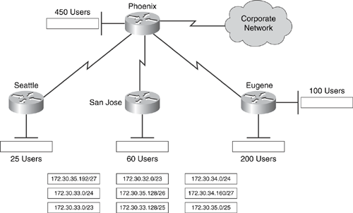
Self Assessment:
Widget, Inc., uses the Class B address 172.30.0.0/16 to address its organization. The western region of the organization (shown in Figure) has been allocated the 172.30.32.0/20 block. As the administrator of the Phoenix office, you are required to allocate valid subnets to the HQ and three branch offices shown in Figure. Draw lines showing the subnet that should be assigned to each office. All answers will not be used.

Slide 51
Thank You…

